Slide 1
Directed Graphs
BOS
ORD
JFK
SFO
DFW
LAX
MIA
Directed Graphs
Notes:
Shortest Path

Slide 2
Digraphs
A digraph is a graph whose edges are all directed
  Short for “directed graph”
Applications
  one-way streets
  flights
  task scheduling
E
D
C
B
A
Directed Graphs

Slide 3
Digraph Properties
E
D
C
A graph G=(V,E) such that
  Each edge goes in one direction:
  Edge (a,b) goes from a to b, but not b to a
If G is simple, m < n⋅(n − 1)
If we keep in-edges and out-edges in separate adjacency lists, we can perform listing of incoming edges and outgoing edges in time proportional to their size
B
A
Directed Graphs

Slide 4
Digraph Application
Scheduling: edge (a,b) means task a must be completed before b can be started
ics21
ics22
ics23
ics51
ics53
ics52
ics161
ics131
ics141
ics121
ics171
The good life
ics151
Directed Graphs

Slide 5
Directed DFS
We can specialize the traversal algorithms (DFS and BFS) to digraphs by traversing edges only along their direction
In the directed DFS algorithm, we have four types of edges
  discovery edges
  back edges
  forward edges
  cross edges
A directed DFS starting at a vertex s determines the vertices reachable from s
E
D
C
B
A
Directed Graphs

Slide 6

Reachability
DFS tree rooted at v: vertices reachable from v via directed paths
E
D
E
D
C
A
C
F
E
D
A
B
C
F
A
B
Directed Graphs

Slide 7
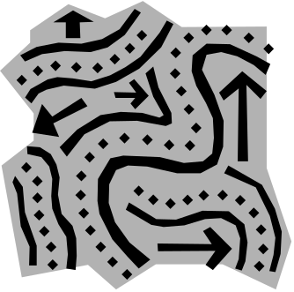
Strong Connectivity
Each vertex can reach all other vertices
a
g
c
d
e
b
f
Directed Graphs

Slide 8
Strong Connectivity Algorithm
Pick a vertex v in G
Perform a DFS from v in G
  If there’s a w not visited, print “no”
Let G’ be G with edges reversed
Perform a DFS from v in G’
  If there’s a w not visited, print “no”
  Else, print “yes”
Running time: O(n+m)
G:
a
c
g
d
e
f
b
a
G’:
c
g
d
e
f
b
Directed Graphs

Slide 9

Strongly Connected Components
Maximal subgraphs such that each vertex can reach all other vertices in the subgraph
Can also be done in O(n+m) time using DFS, but is more complicated (similar to biconnectivity).
a
g
{ a , c , g }
c
d
e
{ f , d , e , b }
f
b
Directed Graphs

Slide 10
Transitive Closure
Given a digraph G, the transitive closure of G is the digraph G* such that
  G* has the same vertices as G
  if G has a directed path from u to v (u ≠ v), G* has a directed edge from u to v
The transitive closure provides reachability information about a digraph
D
E
B
G
C
A
D
E
B
C
A
G*
Directed Graphs

Slide 11

Computing the Transitive Closure
If there's a way to get from A to B and from B to C, then there's a way to get from A to C.
We can perform DFS starting at each vertex
  O(n(n+m))
Alternatively ... Use dynamic programming: The Floyd-Warshall Algorithm
Directed Graphs

Slide 12
Floyd-Warshall Transitive Closure
Idea #1: Number the vertices 1, 2, …, n.
Idea #2: Consider paths that use only vertices numbered 1, 2, …, k, as intermediate vertices:
Uses only vertices numbered 1,…,k
(add this edge if it’s not already in)
i
j
Uses only vertices
numbered 1,…,k-1
Uses only vertices
numbered 1,…,k-1
k
Directed Graphs

Slide 13
Floyd-Warshall’s Algorithm
Number vertices v₁ , …, v_{n}
Compute digraphs G₀, …, G_{n}
  G₀=G
  G_{k} has directed edge (v_{i}, v_{j}) if G has a directed path from v_{i} to v_{j} with intermediate vertices in
  {v₁ , …, v_{k}}
We have that G_{n} = G*
In phase k, digraph G_{k} is computed from G_{k − 1}
Running time: O(n³), assuming areAdjacent is O(1) (e.g., adjacency matrix)
Algorithm FloydWarshall(G)
Input digraph G
Output transitive closure G* of G
i ← 1
for all v ∈ G.vertices()
denote v as v_{i}
i ← i + 1
G₀ ← G
for k ← 1 to n do
G_{k} ← G_{k − 1}
for i ← 1 to n (i ≠ k) do
for j ← 1 to n (j ≠ i, k) do
if G_{k − 1}.areAdjacent(v_{i}, v_{k}) ∧
G_{k − 1}.areAdjacent(v_{k}, v_{j})
if ¬G_{k}.areAdjacent(v_{i}, v_{j})
G_{k}.insertDirectedEdge(v_{i}, v_{j} , k)
return G_{n}
Directed Graphs

Slide 14
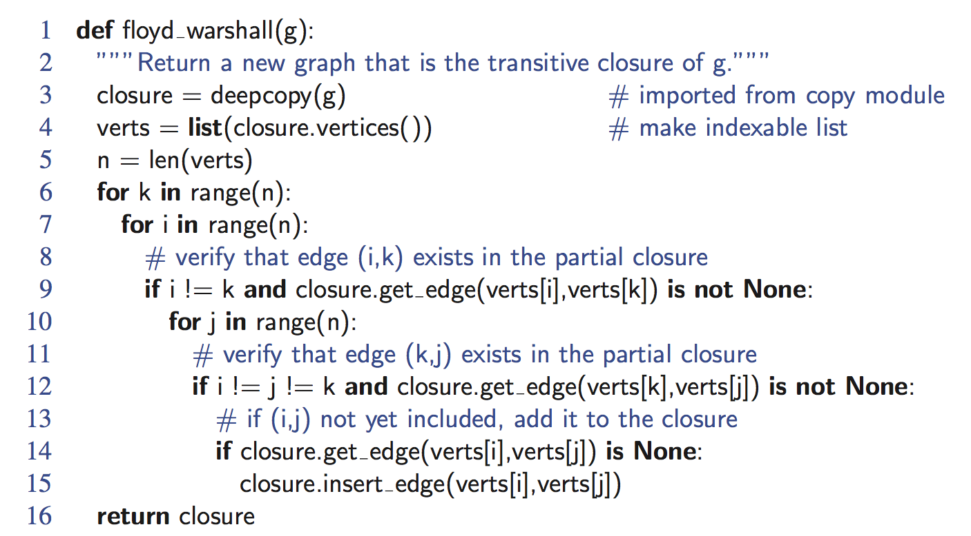
Python Implementation
Directed Graphs

Slide 15


Floyd-Warshall Example
BOS
ORD
v
4
JFK
v
2
v
6
SFO
DFW
LAX
v
v
3
1
MIA
v
5
Directed Graphs

Slide 16
Floyd-Warshall, Iteration 1
BOS
ORD
v
4
JFK
v
2
v
6
SFO
DFW
LAX
v
v
3
1
MIA
v
5
Directed Graphs

Slide 17
Floyd-Warshall, Iteration 2
BOS
ORD
v
4
JFK
v
2
v
6
SFO
DFW
LAX
v
v
3
1
MIA
v
5
Directed Graphs

Slide 18
Floyd-Warshall, Iteration 3
BOS
ORD
v
4
JFK
v
2
v
6
SFO
DFW
LAX
v
v
3
1
MIA
v
5
Directed Graphs

Slide 19
Floyd-Warshall, Iteration 4
BOS
ORD
v
4
JFK
v
2
v
6
SFO
DFW
LAX
v
v
3
1
MIA
v
5
Directed Graphs

Slide 20
Floyd-Warshall, Iteration 5
BOS
ORD
v
4
JFK
v
2
v
6
SFO
DFW
LAX
v
v
3
1
MIA
v
5
Directed Graphs

Slide 21
Floyd-Warshall, Iteration 6
BOS
ORD
v
4
JFK
v
2
v
6
SFO
DFW
LAX
v
v
3
1
MIA
v
5
Directed Graphs

Slide 22
Floyd-Warshall, Conclusion
BOS
ORD
v
4
JFK
v
2
v
6
SFO
DFW
LAX
v
v
3
1
MIA
v
5
Directed Graphs

Slide 23
DAGs and Topological Ordering
D
E
A directed acyclic graph (DAG) is a digraph that has no directed cycles
A topological ordering of a digraph is a numbering
v₁ , …, v_{n}
of the vertices such that for every edge (v_{i} , v_{j}), we have i < j
Example: in a task scheduling digraph, a topological ordering a task sequence that satisfies the precedence constraints
Theorem
A digraph admits a topological ordering if and only if it is a DAG
B
C
A
DAG G
v₄
v₅
D
E
v₂
B
v₃
v₁
C
Topological ordering of G
A
Directed Graphs

Slide 24

Topological Sorting
Number vertices, so that (u,v) in E implies u < v
wake up
1
A typical student day
2
3
eat
study computer sci.
4
5
nap
more c.s.
7
play
8
write c.s. program
6
9
work out
bake cookies
10
sleep
11
dream about graphs
Directed Graphs

Slide 25
Algorithm for Topological Sorting
Note: This algorithm is different than the one in the book
Running time: O(n + m)
Algorithm TopologicalSort(G)
H ← G // Temporary copy of G
n ← G.numVertices()
while H is not empty do
Let v be a vertex with no outgoing edges
Label v ← n
n ← n − 1
Remove v from H
Directed Graphs

Slide 26
Implementation with DFS
Simulate the algorithm by using depth-first search
O(n+m) time.
Algorithm topologicalDFS(G, v)
Input graph G and a start vertex v of G
Output labeling of the vertices of G
in the connected component of v
setLabel(v, VISITED)
  for all e ∈ G.outEdges(v)
  { outgoing edges }
  w ← opposite(v,e)
  if getLabel(w) = UNEXPLORED
  { e is a discovery edge }
  topologicalDFS(G, w)
  else
  { e is a forward or cross edge }
  Label v with topological number n
  n ← n - 1
Algorithm topologicalDFS(G)
Input dag G
Output topological ordering of G
n ← G.numVertices()
  for all u ∈ G.vertices()
  setLabel(u, UNEXPLORED)
  for all v ∈ G.vertices()
  if getLabel(v) = UNEXPLORED
  topologicalDFS(G, v)
Directed Graphs

Slide 27
Topological Sorting Example
Directed Graphs

Slide 28
Topological Sorting Example
9
Directed Graphs

Slide 29
Topological Sorting Example
8
9
Directed Graphs

Slide 30
Topological Sorting Example
7
8
9
Directed Graphs

Slide 31
Topological Sorting Example
6
7
8
9
Directed Graphs

Slide 32
Topological Sorting Example
6
5
7
8
9
Directed Graphs

Slide 33
Topological Sorting Example
4
6
5
7
8
9
Directed Graphs

Slide 34
Topological Sorting Example
3
4
6
5
7
8
9
Directed Graphs

Slide 35
Topological Sorting Example
2
3
4
6
5
7
8
9
Directed Graphs

Slide 36
Topological Sorting Example
2
1
3
4
6
5
7
8
9
Directed Graphs

